Slide 1
Week 7 (1) – 2-3 Trees
CST370 – Design & Analysis of Algorithms
Dr. Byun
Computer Science

Slide 2
Lecture Objectives
After completion of this lecture, you will be able to
  explain the definition of the 2-3 trees and conduct insertion operations to a 2-3 tree.

Slide 3
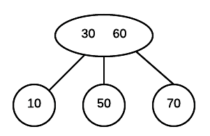
2-3 Trees
A 2-3 tree is a search tree.
  Each node can have one or two values.
  All leaves of a 2-3 tree are at the same level.
Example
Source: https://cathyatseneca.gitbooks.io/data-structures-and-algorithms/2-3_trees/

Slide 4
<<< Course Instruction >>>
Watch this video to understand the definition of the 2-3 tree and its insertion operation.
  You don’t need to watch the whole video, especially the implementation part.
  Watch it from the beginning to 6:57.
  https://goo.gl/4upYaR

Slide 5
<<< Course Instruction >>>
Read the figure 6.8 of the textbook (page 225)
  The figure explains how to insert 9, 5, 8, 3, 2, 4, and 7 to construct a 2-3 tree.

Slide 6
Exercise
Construct a 2-3 tree for the list 5, 10, 20, 8, 7, 15, 30, and 11.
Do not see the answer immediately.
  Try to solve it by yourself.

Slide 7
Solution
Watch this video from 6:48 to 10:22 for a solution to the problem.
  https://goo.gl/Kd7k1o

Slide 8
<<< Course Instruction >>>
Read pages 223-225 in the textbook and proceed to the next slide.

Slide 9
<<< Course Instruction >>>
This lecture is over.
  When you are done, study the next lesson (week_7_2.ppt) on the iLearn.

